Slide 1

Cryvesto 2.0
Presenter Dana Hayes
Notes:
Hello Class, My name is Dana Hayes, Chief Product Officer, and would like to introduce Cryvesto 2.0.

Slide 2




Agenda
Intro: Executive Summary & Project Goals
Approach to Achieve Goals
Research & Data Preparation
The Selected Model
Results & conclusion or Application
Future Next Steps
Notes:
Elaborate from the screen

Slide 3




Intro & Proposal
Team Cryvesto 2.0 attempts to construct a Machine Learning Sentiment Trade Bot (ML-STB) that identifies ‘Bullish’ or ‘Bearish’ market sentiment from news and social media sources.
We believe that positive and negative sentiment sets market trends.
Utilizing the aggregated data metrics, we aim to generate trade signals in response to ‘fear’ and ‘greed’ expressions.
Notes:
In this Project, team Cryvesto 2.0 constructs a Machine Learning Sentiment Trade Bot(ML_STB) that utilizes market expressions news and social media sources that responds to ‘Bullish’ or ‘Bearish’ signals. We believe that positive and negative sentiment sets market trends. By encoding these sentiment trends as ‘Bullish’ or ‘Bearish’ signals we can trigger entry or exit points to trade targeted securities or assets.
Have you heard of popular trading industry phrases, such as the "The trend is your friend." or "Buy on the rumor, sell on the news?" These phrases can't be ignored as they are among many other expressions like “Diamond hands” being encapsulated on the internet in popular social media sites like "Twitter” and, "Reddit’s Wall Street Bets". Today with newer sites focused on block chain and cryptocurrency, such as ‘Bitcointalks’, ‘Mamby’, and e-mag’s ‘Medium’ the sentiment is proliferating.

Slide 4


Executive Summary
We believe that our analysis of sentiment identifies the influential market forces of ‘fear’ and ‘greed’ and can be leading indicators for trade points.
Our hypothesis:
In a time period, when 'Bullish' sentiment is high asset prices will likely rise and when 'Bearish' sentiment is high the opposite will occur with asset prices declining.
Notes:
With the growth of high frequency trading(HFT) rising to 80% of market trading today, it gives cause to seek a different approach from automated ML algorithm modeling based on traditional technical indicator inputs that trigger entry and exit points. We aim to capture investor sentiment to get an early advantage to place trades before traditional HFT trade signals.
As such, our hypothesis is when the 'Bullish' sentiment is higher than 'Bearish' sentiment the asset price will likely rise, and when 'Bearish' sentiment is higher than 'Bullish' sentiment the opposite will be true with declining prices. Our research of sentiment comparisons highlights the influential market forces of ‘fear’ and ‘greed’ as leading indicators for trade points on specified assets.

Slide 5






Team Cryvesto
Anna Joltaya
Ashok Pandey
Dana Hayes
Scott Marler
Rensley Ramos
Chief R & D Officer
Chief Computer Scientist
Chief of Product Development
Chief Technology Officer
Chief Marketing & Sales Executive
Notes:
Now to introduce the Cryvesto Team…

Slide 6
Data Analysis
Sources of Data
API’s Considered
Twitter
Reddit
Wall Street Journal
News Api
TextBlob
NLTK(used)
Augmento (used)
Twitter
NewsAPI(used)
Notes:
Now I leave you with our Chief R & D Officer, Anna Joltaya…We specifically source our data from business news & internet social media to utilize it for our program. API’s considered and actually used for our research and development are TextBlob, NLTK, Augmento, Twitter and NewsAPI.

Slide 7
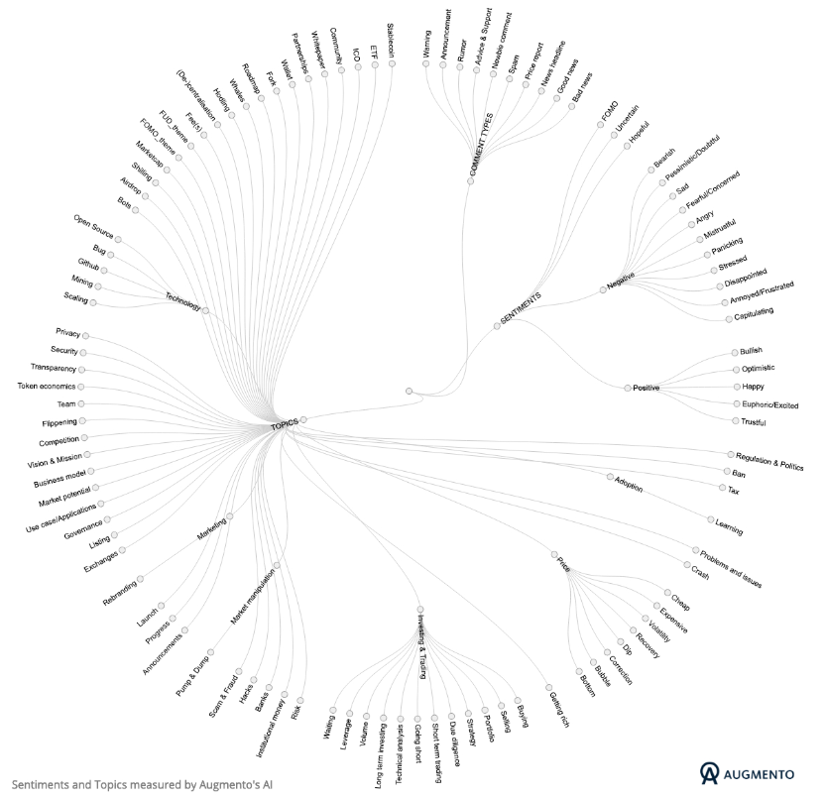

Augmento’s “Sentiment Polarity Indicator” for Cryptocurrencies
More than 100 sentiments relating to topics of discussion about cryptocurrencies on social media from Twitter, Bitcointalk & Reddit.
Notes:
As illustrated, Augmento’s AI quantifies more than 100 sentiment relating to topics of discussion with key words and phrases about crypto currencies on social media- Twitter, Bitcointalk, and Reddit. In observation some sentiments are visualized as opposites.

Slide 8
List of Sentiments Tracked through Augmento’s API
BULLS
Bears
Bullish
Hopeful
Optimistic
Happy
Euphoric
Excited
Bearish
Pessimistic
Doubtful
Sad
Fearful/Concerned
Angry
Mistrustful
Panicking
Annoyed/Frustrated
Notes:
Here we narrowed down Augmento’s 100 sentiments to a list of 15 from the Augmento API for our data base to serve our purpose for research in building our program.

Slide 9
The Models
Models Analyzed
Signal Strategy
SVC
Logistic Regression
AdaBoost (Recommended for consistent predictability for both signals)
Random Forrest
Neural Networks
Simple Strategy – (KISS works)
Strategy combines different levels of sentiment polarity to determine signals
SMA Short/Long – SMA of Sentiments instead of daily returns
Notes:
Good evening folks. After receiving the crypto sentiment data drawn from AUGMENTO we created the FEATURE and TARGET sets for our models.
The FEATURE set included 15 sentiments you just saw, drawn from Twitter and Reddit. The Target was kept at the simple strategy of change in DAILY_RETURNS,
We tested the data for BITCOIN and ETHEREUM sentiments on FOUR Models- Logistic Regression, SVC, Adaboost and Random Forest with the results shown in the next slide.

Slide 10
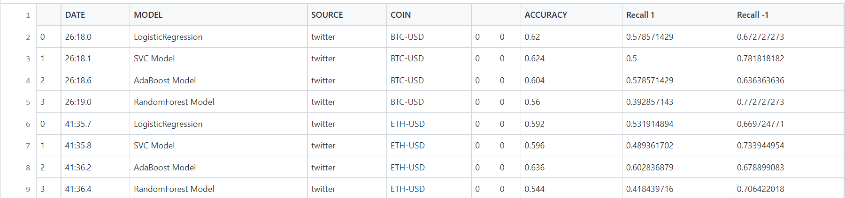
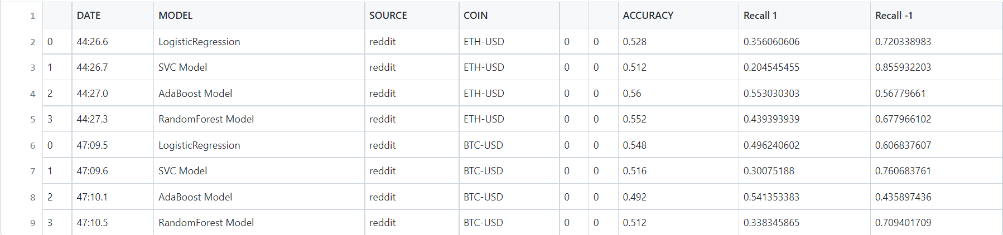
Algo Model Classification Reports
Twitter Classification Report
Reddit Classification Report
Notes:
This is a sample of numerous tests we ran on our models. As you can see the performance of Adaboost is at around 60% accuracy with similar recall values for both BUY AND SELL indicators. Adaboost outperformed all the models tested even in CUMULATIVE RETURNS.

Slide 11
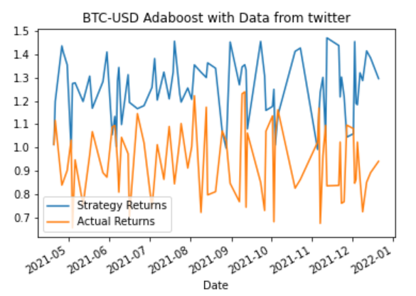
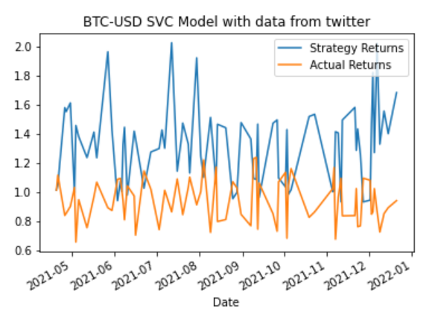
Actual Returns vs Strategy Returns Charts
Twitter Sentiments BTC with Adaboost
Twitter Sentiments BTC with
SVC
Notes:
With Adaboost model The Cumulative Returns have been consistently better than Actual Returns as you can see across the four models for Bitcoin and Ethereum from both twitter as well as reddit data feeds. Next slide and then NEXT Slide.

Slide 12
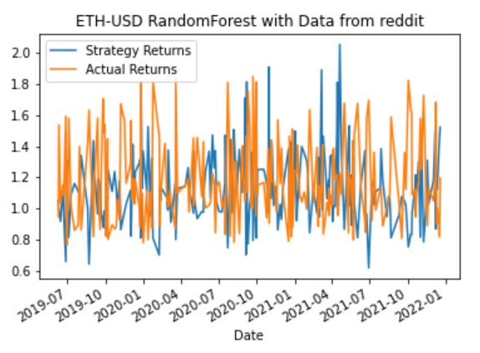
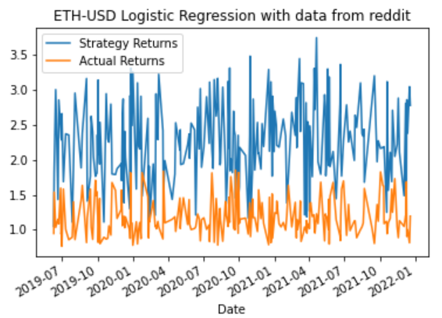
Actual Returns vs Strategy Returns Charts
Reddit Sentiment Ethereum Random Forest
Reddit Sentiment Ethereum Logistic Regression
Notes:
With Adaboost model The Cumulative Returns have been consistently better than Actual Returns. As you can see across the four models for Bitcoin and Ethereum from both twitter and reddit data feeds. Next slide and then NEXT Slide.

Slide 13
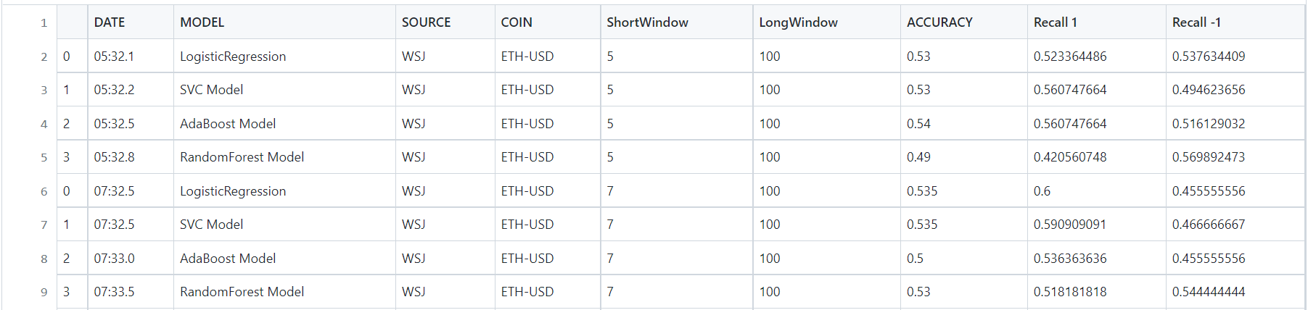
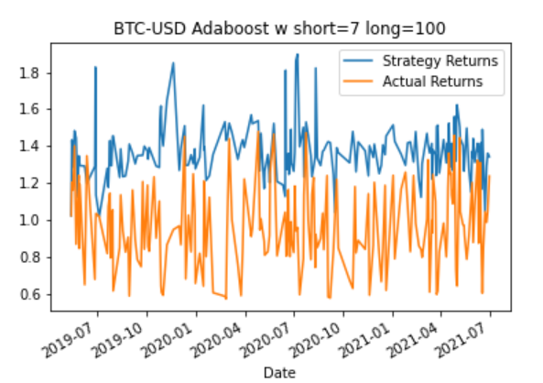
Wall Street Journal Headlines Sentiment Results
Notes:
With Adaboost model The Cumulative Returns have been consistently better than Actual Returns as you can see across the four models for Bitcoin and Ethereum from both twitter as well as reddit data feeds. NEXT Slide Please.

Slide 14
The Cryvesto Approach to Achieve Project Goals
Backtested the models and compared Classification reports with Cumulative Returns
Issues anticipated to tame the model
Placed strategic modifications in the signal coding
Backtested many trial runs with different configurations
Analyzed several Neural Network performance runs
Converted Classification Reports & Charts to pandas for efficiency and avoid the tedious backtesting process of changing parameters and recording.
Notes:
During the research and development we encountered many issues relating to different Signal strategies. Found out that the best strategy was the simplest one we chose.

Slide 15

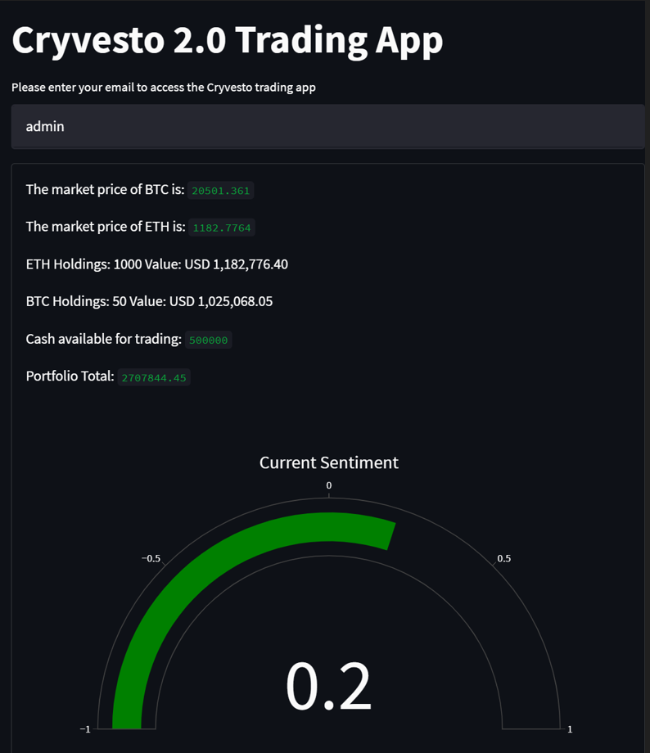
The Cryvesto Sentiment Meter
The ML-STB program signals a bull market
Notes:
The Machine Learning Sentiment Meter (ML-STB) is embedded in our trading application for crypto currency account holders. This gives the latest signal indicating bullish or bearish sentiment along with their current account information prior to entering a trade. This assist them with the latest market conditions of the asset or security of interest prior to entering a trade.

Slide 16
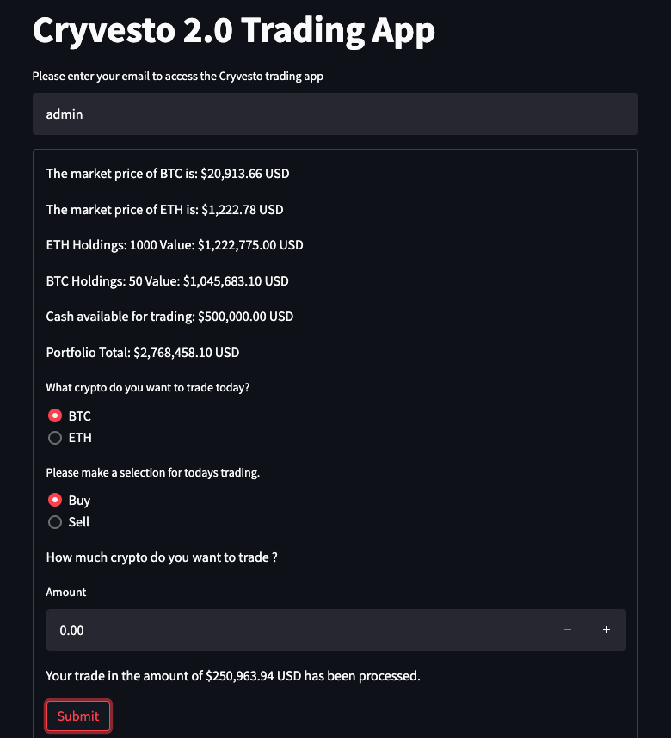

Cryvesto 2.0 ML-STB Graphic User Interface using Streamlit
Notes:
A Machine Learning to Trade with Captured Sentiments! Is the Cryvesto 2.0 Machine Learning Sentiment Trade Bot(ML_STB) interfaced with Streamlit application. The Streamlit application framework enables our python code to be interactive with the user on a local computer. When Streamlit is activated, with `run my_app.py` a web server from the Streamlit cloud runs the app on a local computer. This allows the user to retrieve account information and place trades over a secure network hosted and managed within the Google Cloud Platform.

Slide 17

Summary
Benefits:
Cryvesto gets ahead of trends before they occur on the market.
s are executed at the best possible prices
Trades are timed correctly and instantly to avoid significant price changes before volatility increases in the marketplace- adding targeted security.
of trends before they occur on the market.
Trades are executed at the best possible prices
Notes:
Rensley Ramos speaks:

Slide 18

Future Direction
Make Cryvesto app predict with Live Social Media Feed
Refine and develop our proprietary methodology to detect sentiments using latest advances in NLP
Improve our proprietary SMA Sentiments Strategy
File for Copyright and Patent protection for all of our Intellectual Property
Notes:
Talking points are on the screen

Slide 19


Thank You
Team Cryvesto 2.O
1101011001@cti.com
Cryvesto Technologies Inc.
Notes:
“Thank You for your attention”; and now we’re available for any questions.

